Slide 1
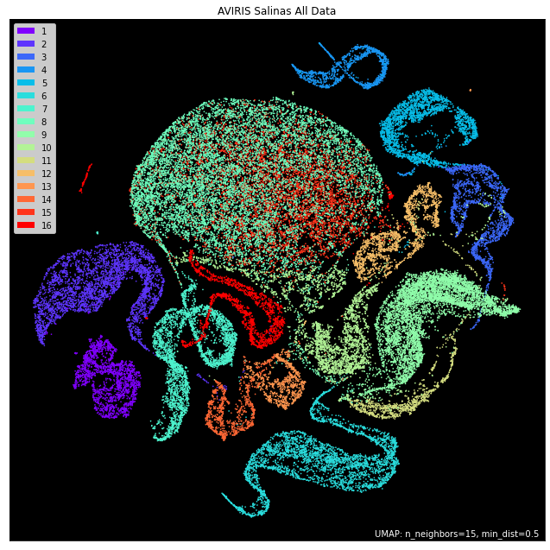
UMAP
Uniform Manifold Approximation and Projection

Slide 2
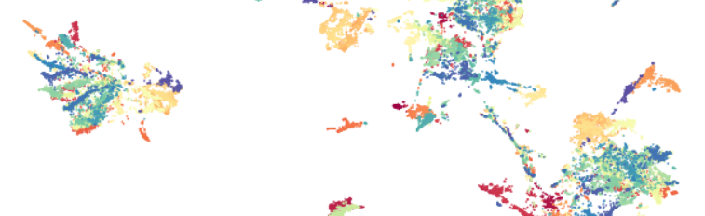
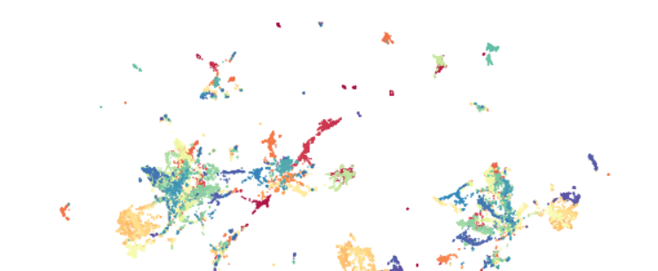
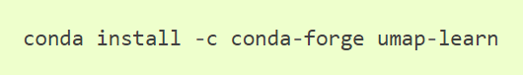
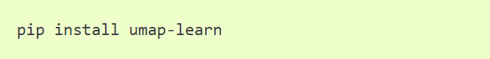
UMAP Quick Facts
What: Dimensionality reduction (DR) and visualization.
Speed: Very fast. Slower than PCA and faster than tSNE
Good For: DR of any finite metric space. Preserving local and global structure of data throughout DR.
Poor For: Datasets with isolated points.
OR

Slide 3
UMAP Algorithm
Compute Neighborhood Graph
KNN Searching,
Determine local metrics.
Construct non-symmetric weighted adjacency matrix from local metrics.
Combine local metrics to construct symmetric weighted adjacency matrix.
Optimize Graph Layout in Reduced Space
Uses a force directed graph layout algorithm.
OR

Slide 4
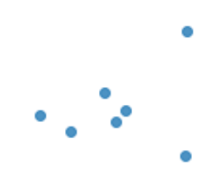
k = 3
Space’s metric is applied to find all edge lengths between k-NN.
Distances are symmetric, so a symmetric adjacency matrix results.

Slide 5
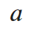
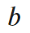
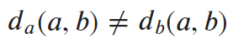
Local Metrics and KNN
… declare the ball which contains one of them to be weight one.
For each point find KNN and…

Slide 6
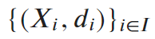
Local Metric Spaces For Everyone!
A collection of local metric spaces .
Immediate consequences:
Dense regions of data have ‘short’ rulers.
Sparse regions of data have ‘long’ rulers.
Instead of having one distance between two points we have two.
In each cluster of k-points, data are approximately uniformly distributed.

Slide 7
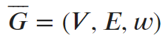
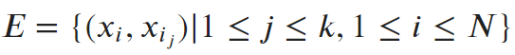
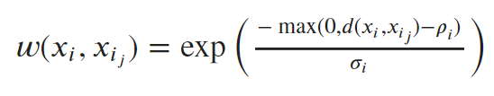
Asymmetric Adjacency Graph
At last we construct an adjacency graph:
V is our entire set of data points.
Local distance from x_{i}’s perspective to j^{th}-NN.
Distance to closest NN.
Normalizing constant ensuring the sum of weights to all NN equals log₂k.

Slide 8
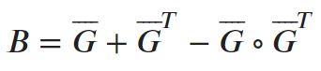
Symmetric Adjacency Matrix
Things to consider:
In weights were probabilities and could be interpreted as, ‘the probability of an edge being included’.
By the construction of B, entries are:
B is symmetric.

Slide 9

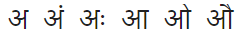
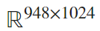
Where: Kaggle
What: Grayscale images of Hindi characters.
Image Size: 32x32 (1024 dimensions)
Image Count: ~304,000 in total (792 images of each of the 384 character combinations).
Data pared to 158 images each of:

Slide 10
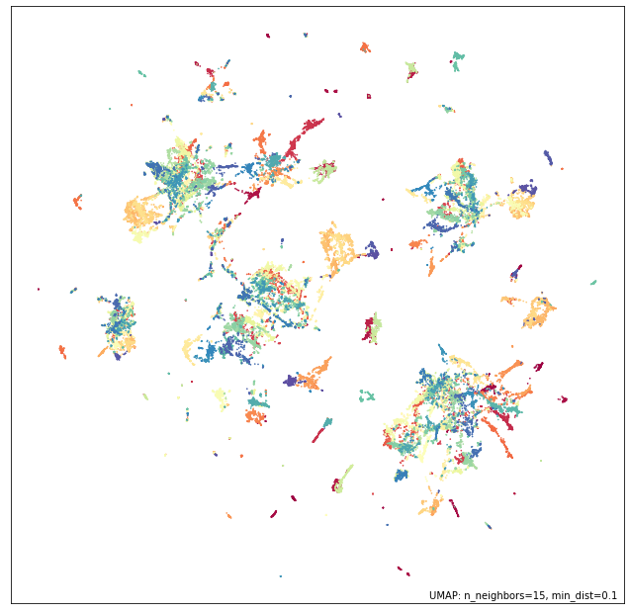
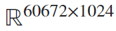
SHABD Results
Data Size:
All 384 characters (color).
158 images of each.
Time: 26.73s

Slide 11
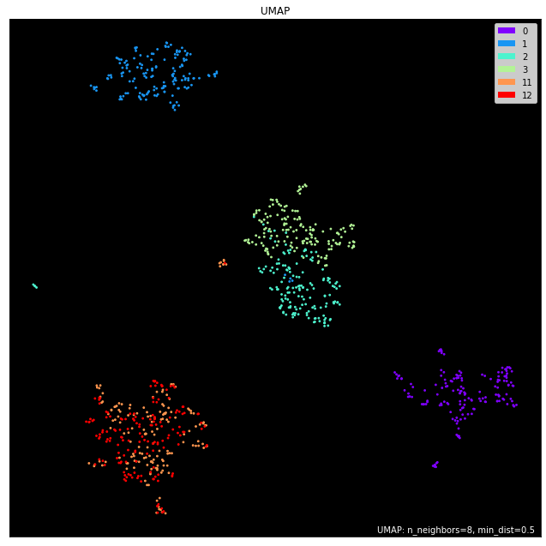
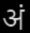
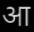
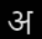
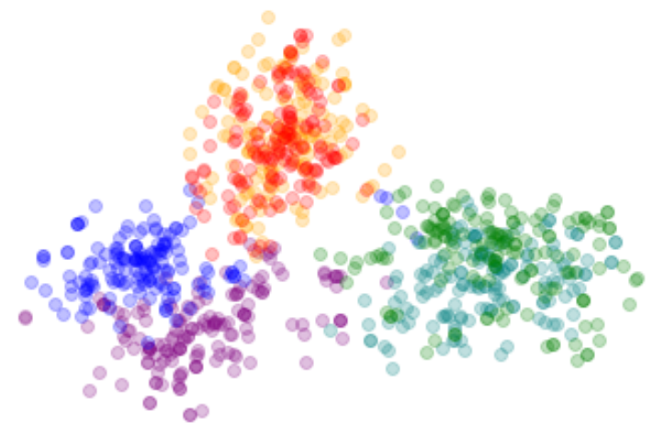

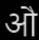
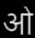
SHABD Results
Data Size:
Time: 2.70s
Right:UMAP
Below: PCA

Slide 12
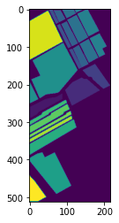
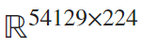
Aerial Visible/Infrared Imaging Spectrometer (AVIRIS)
Where: Salinas Valley, California
What: Image data with 224 dimensions per pixel, each pixel represents a 3.7m by 3.7m patch of Earth.
Pixel Count: ~111,000 with ~54,000 labeled by crop.
How: Big plane, big camera.
Right: A section of Salinas Valley labeled by color with intended crop in a given pixel.

Slide 13
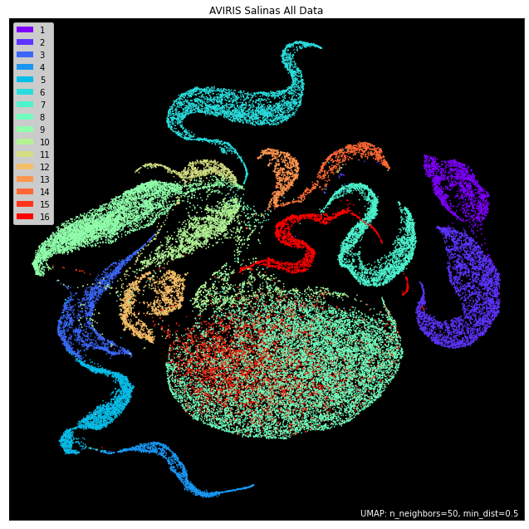
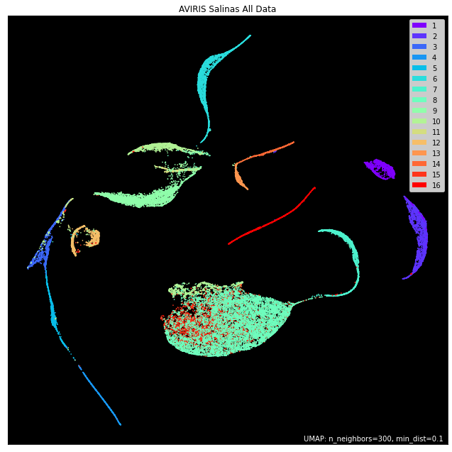
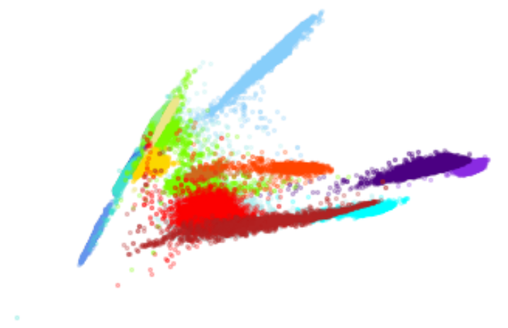
AVIRIS Results
UMAP Left: 47.56s, Top Right: 118.83s
Bot Right: PCA 0.44s

Slide 14
References
GitHub Repo
McInnes, L, Healy, J, UMAP: Uniform Manifold Approximation and Projection for Dimension Reduction, ArXiv e-prints 1802.03426, 2018
Leland McInnes. UMAP-Learn Documentation. 2018. Revision 300cbba8 https://umap-learn.readthedocs.io/en/latest/index.html
John Williamson. What do numbers look like? https://johnhw.github.io/umap_primes/index.md.html
This presentation and ipynb files: https://github.com/AntoineLove?tab=repositories

Slide 15
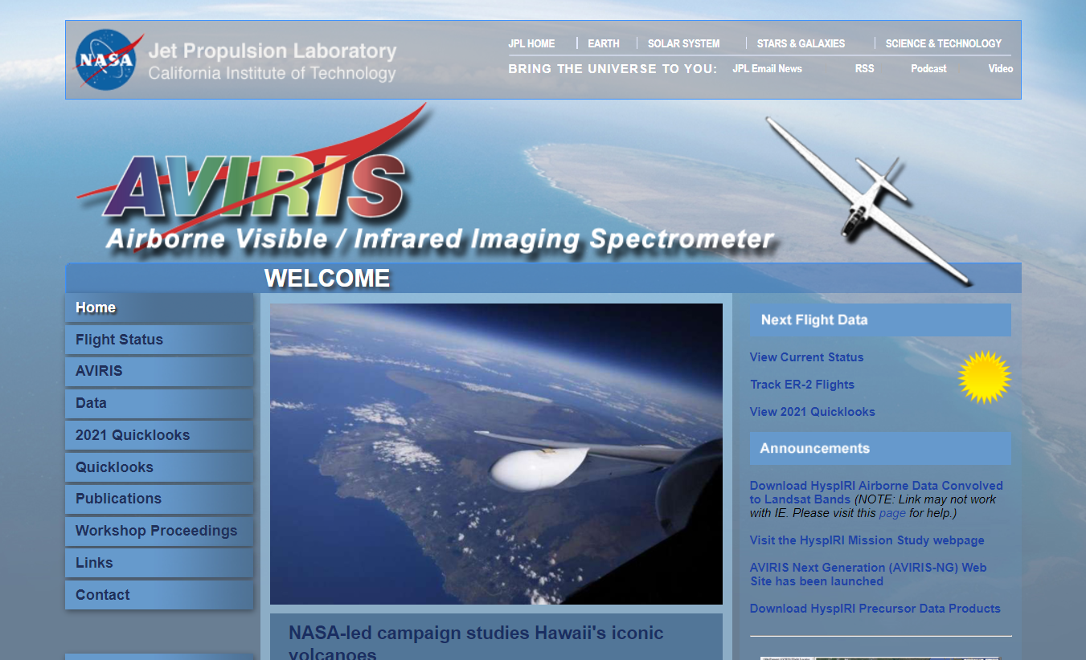

Data Sources
AVIRIS Website: https://aviris.jpl.nasa.gov/
Salinas Dataset:
AVIRIS Data of Salinas Valley, California
Kaggle Dataset
Sampoorna Hindi Akshar Barakhadi Digital Dataset (SHABD Dataset)

Slide 16
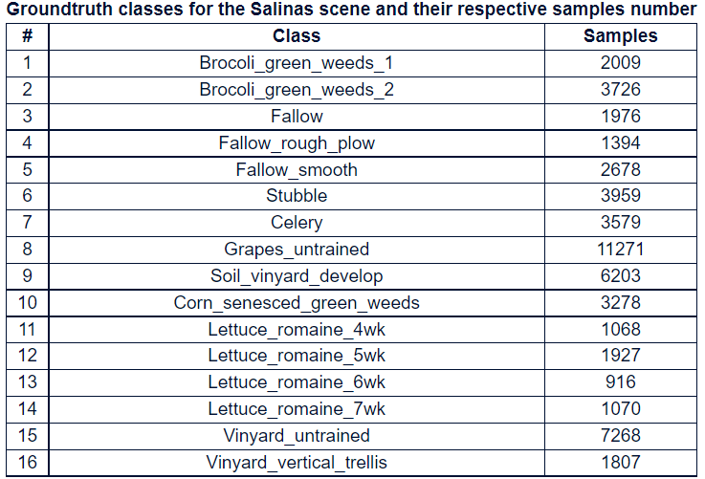
Appendix A: (src Salinas Valley Dataset)

Slide 17
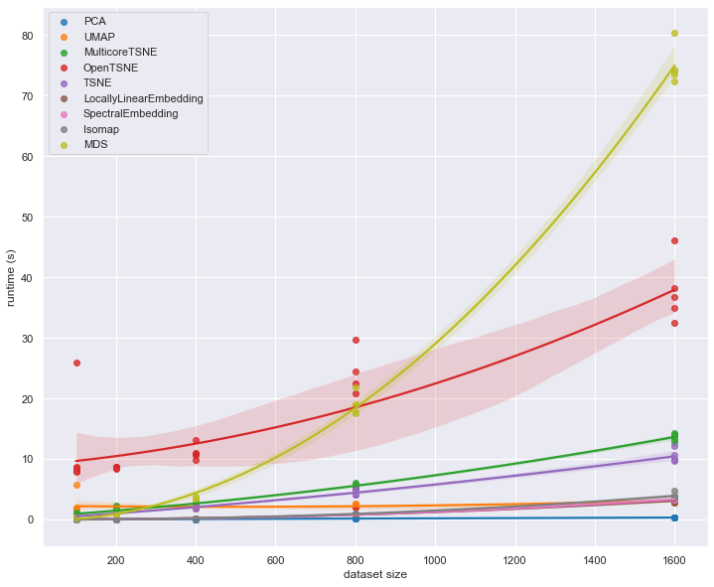
Appendix B: UMAP Performance Comparison
UMAP-Learn Documentation https://umap-learn.readthedocs.io/en/latest/performance.html

Slide 18
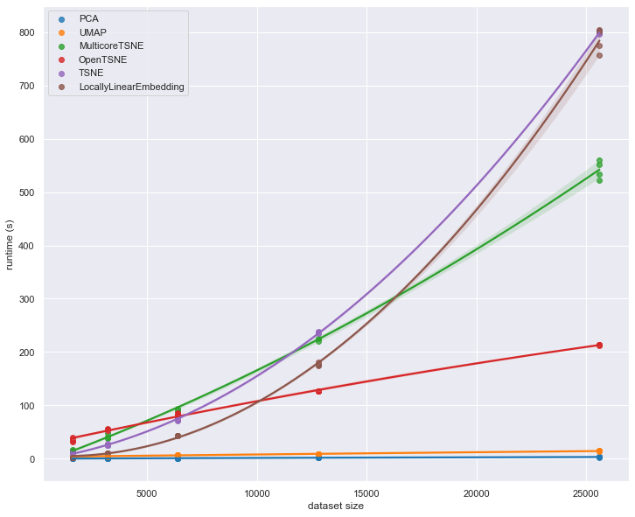
Appendix B: UMAP Performance Comparison
(cont.)
UMAP-Learn Documentation https://umap-learn.readthedocs.io/en/latest/performance.html

Slide 19
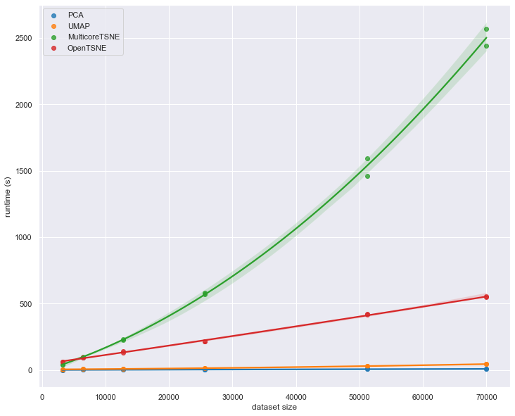
Appendix B: UMAP Performance Comparison
(cont.)
UMAP-Learn Documentation https://umap-learn.readthedocs.io/en/latest/performance.html

Slide 20
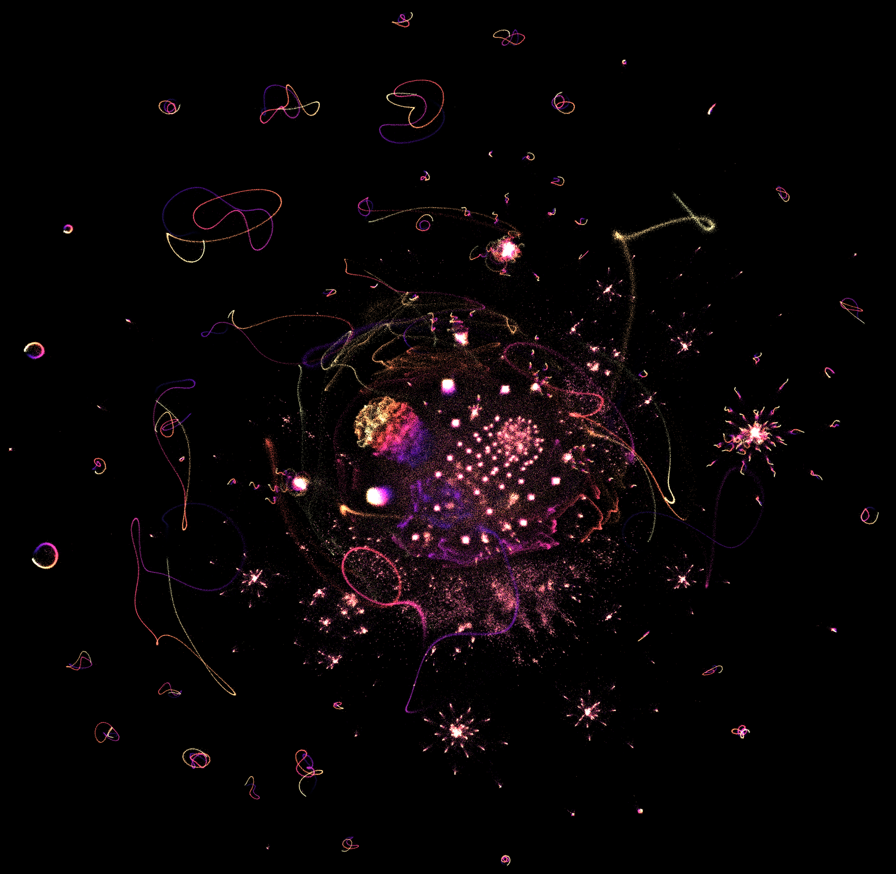
Thank you!
src: What do numbers look like? By John Williamson

Slide 21
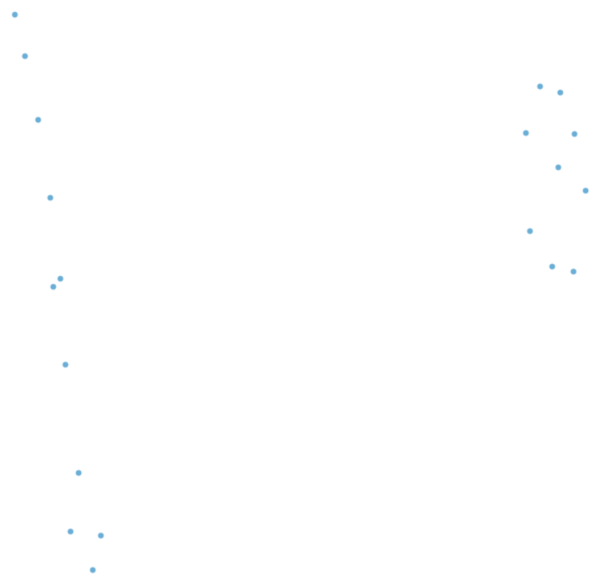
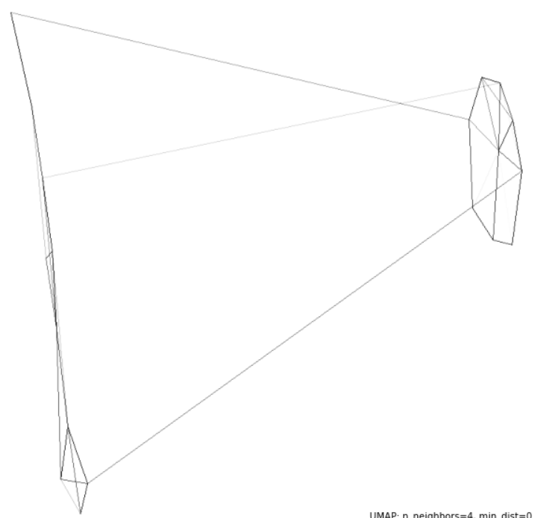
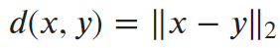
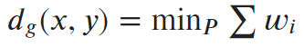
Euclidean Metric
Geodesic Metric

